Slide 1
EN 204
Material Science for Energy Applications
Class 4
Shaibal K Sarkar
Department of Energy Science and Engineering
shaibal.sarkar@iitb.ac.in

Slide 2
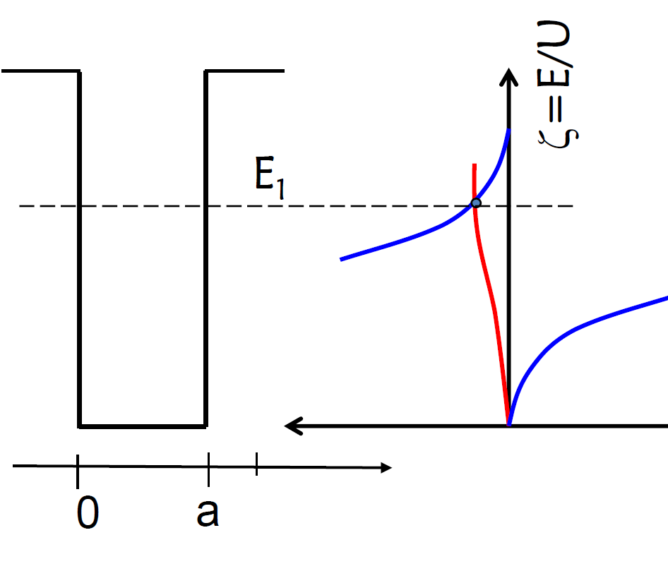
Brief recap
In the last class, we have learnt about determining the electronic states of a loosely bound electron.
What we are up for today?
We will use the previous concept to determine the basic energy band diagram of a solid with infinite periodicity

Slide 3
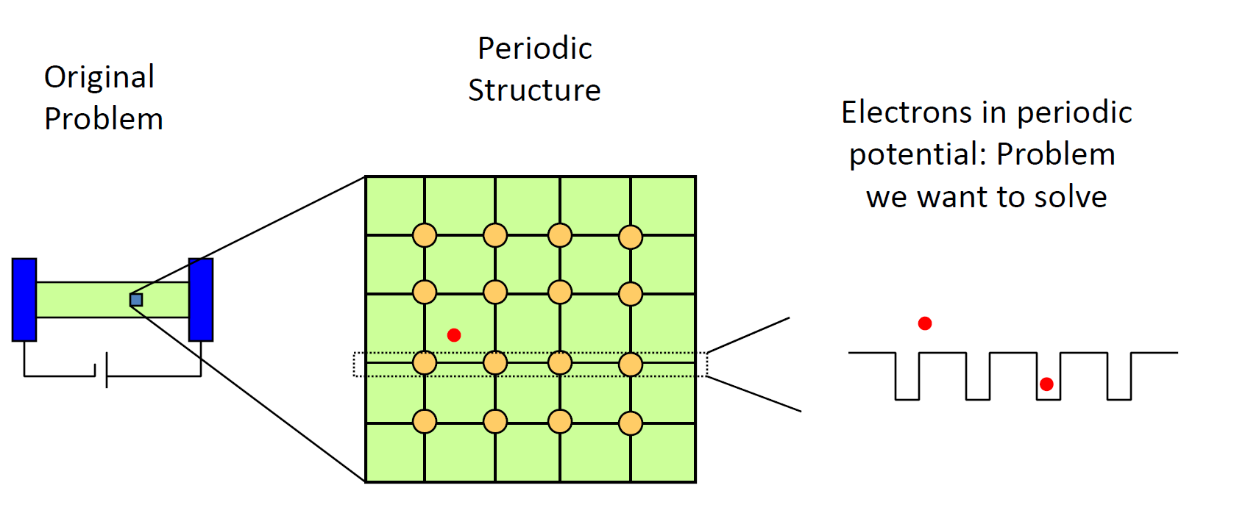
Getting back to crystals…

Slide 4
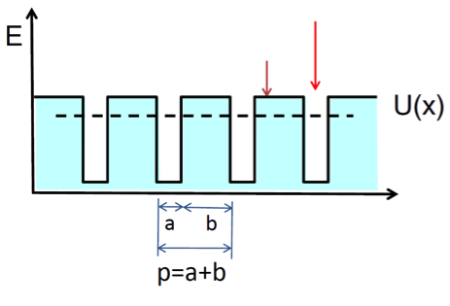
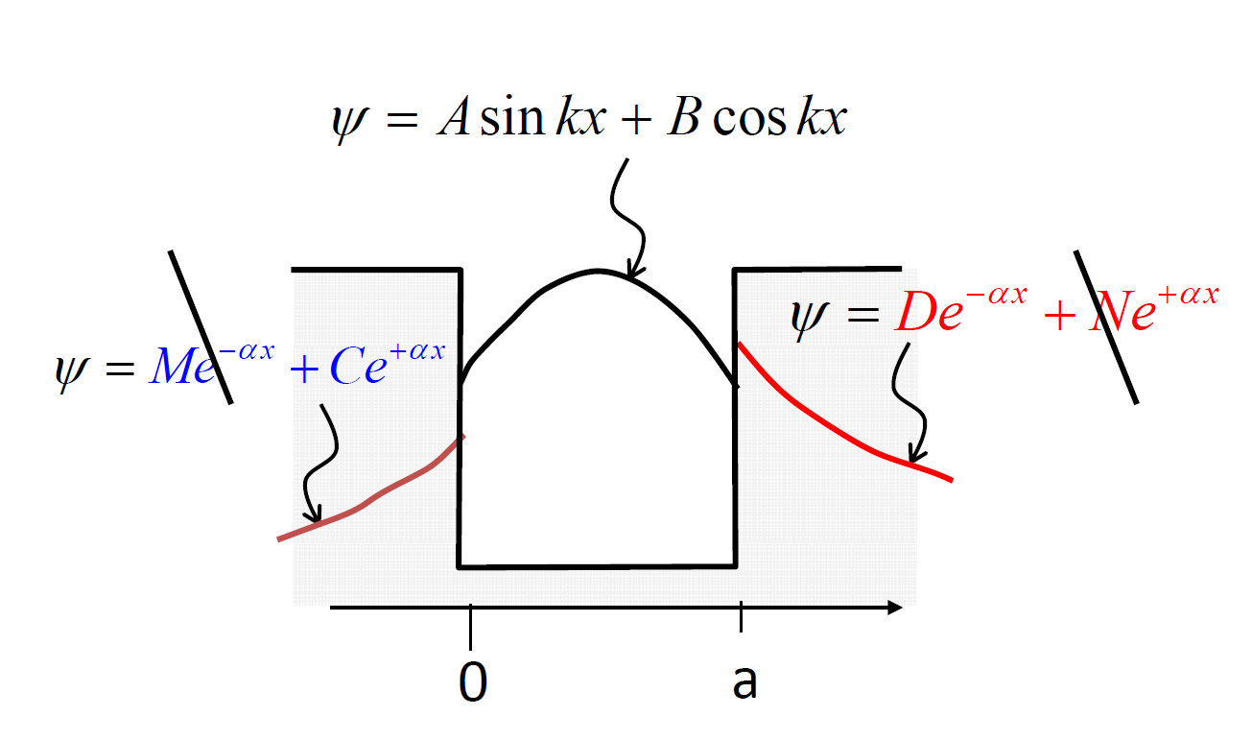


Solving Schrödinger Equation: electron in a periodic potential
$$ψ_{n+1}=A_{n+1}sinkx+ B_{n+1}coskx$$
$$ψ_{n}= C_{n}e^{αx}+D_{n}e^{−αx}$$

Slide 5
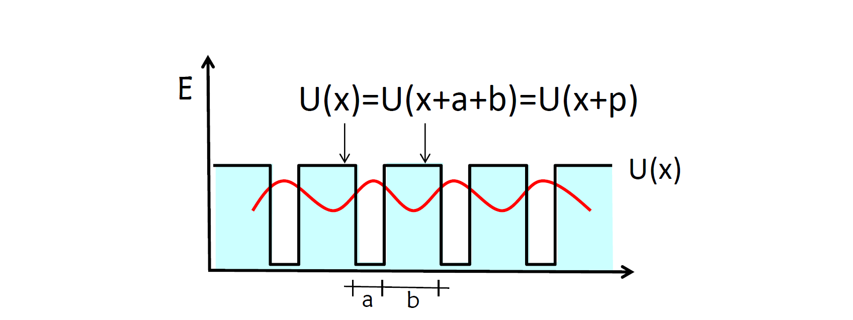


Solving Schrödinger Equation: electron in a periodic potential
Introduction of Phase factor
$${\left|ψ(x)\right|}^{2}={\left|ψ(x+p)\right|}^{2}$$
$ψ\left(x+p\right)=$ $ψ(x)e^{ikp}$

Slide 6
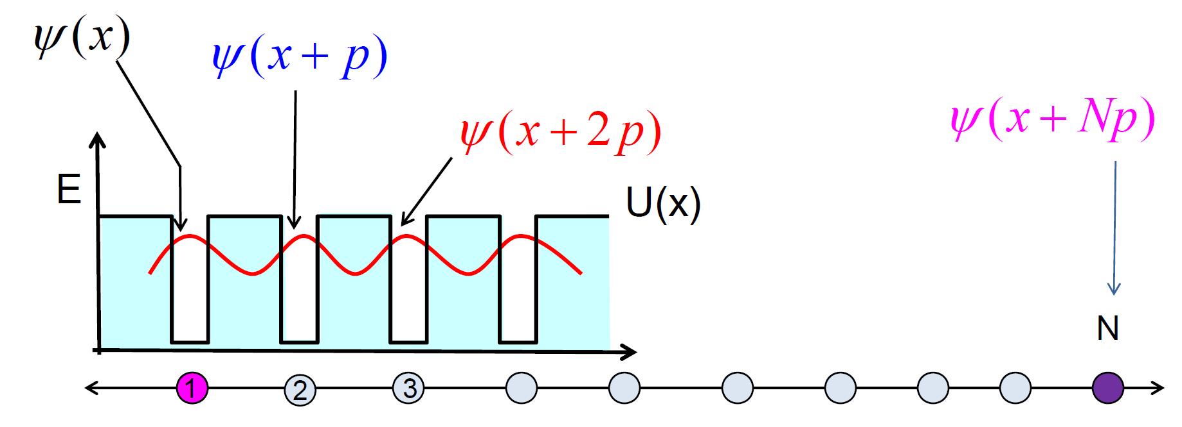




Solving Schrödinger Equation: electron in a periodic potential
Phase factor for N cells
$$ψ\left[x+p\right]=ψ(x)e^{ikp}$$
$$ψ\left[x+2p\right]=ψ[x+p]e^{ikp}$$
$$=ψ(x)e^{2×ikp}$$
$$ψ\left[x+Np\right]=ψ(x)e^{N×ikp}$$

Slide 7
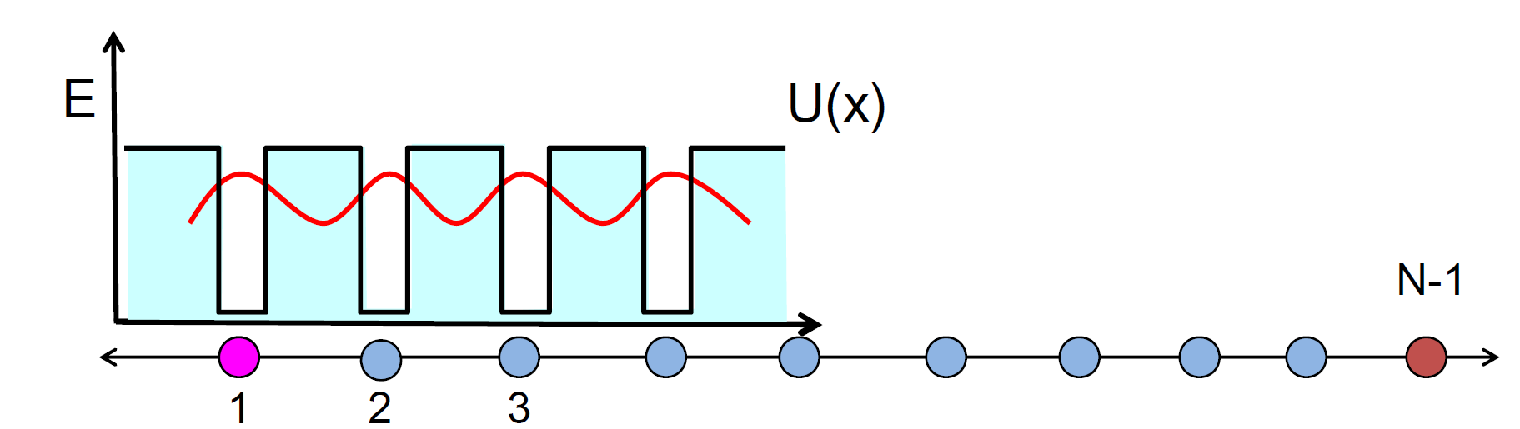
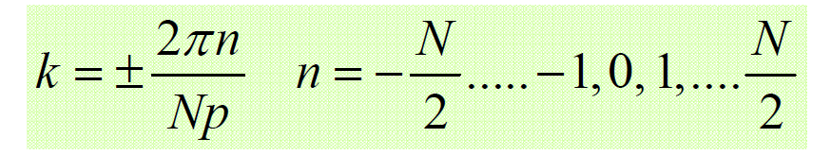
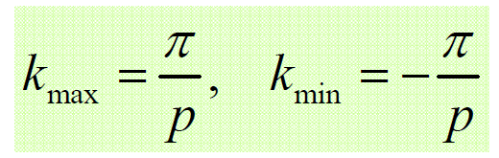



Solving Schrödinger Equation: electron in a periodic potential
Periodic Boundary Condition
$$ψ\left[x+Np\right]=ψ(x)e^{ikpN}$$
$$e^{ikpN}=1$$
$$≡e^{±i2πn}$$

Slide 8
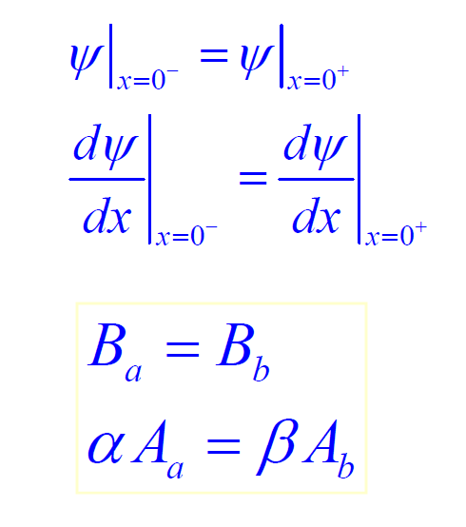
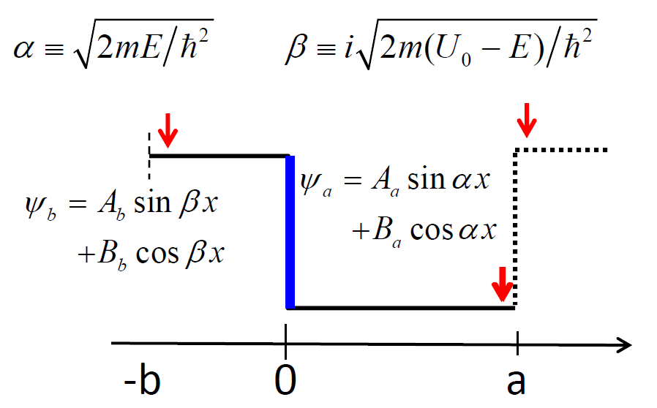
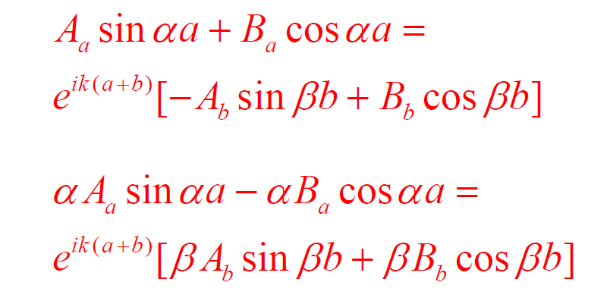
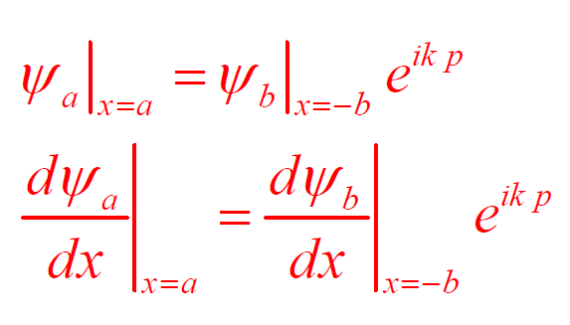
Solving Schrödinger Equation: electron in a periodic potential
Periodic Boundary Condition

Slide 9
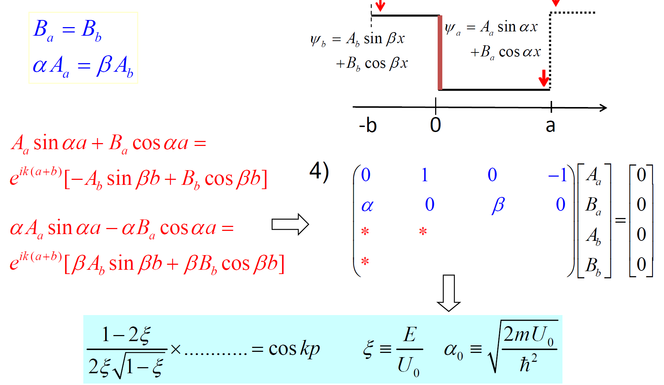
Δ (matrix) = 0 for Energy Levels

Slide 10
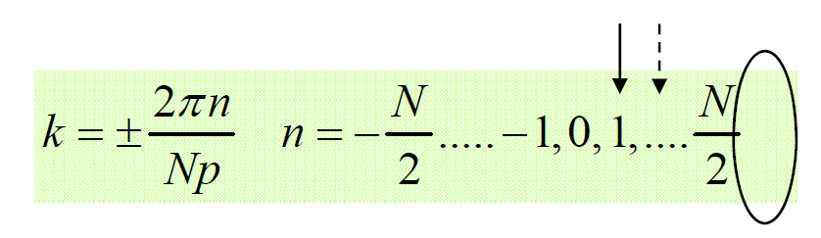
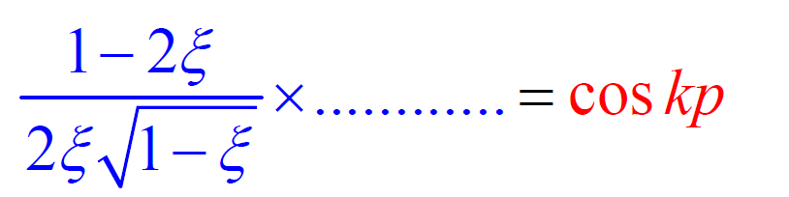
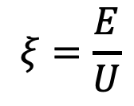
Graphical Solution to Energy Levels
k=0 →+1
$$ξ=\frac{E}{U}$$

Slide 11
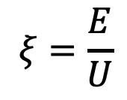
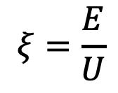
Graphical Solution to Energy Levels
$$ξ=\frac{E}{U}$$
$$ξ=\frac{E}{U}$$

Slide 12
Graphical Solution to Energy Levels
k
+1
- π/p
π/p

Slide 13
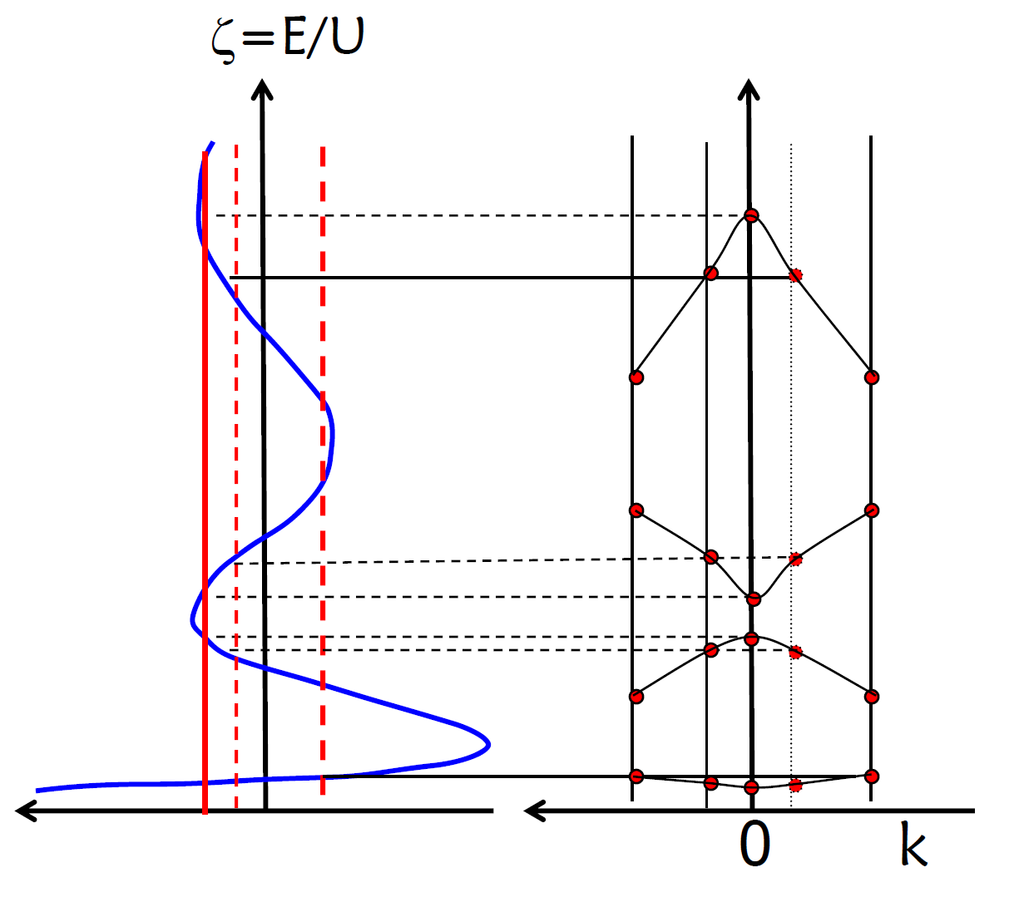
Graphical Solution to Energy Levels – Energy Band Diagram

Slide 14
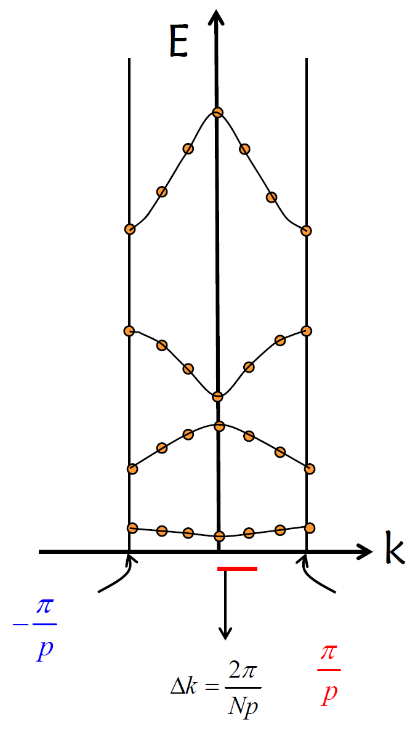
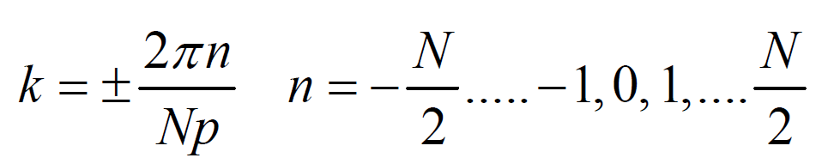
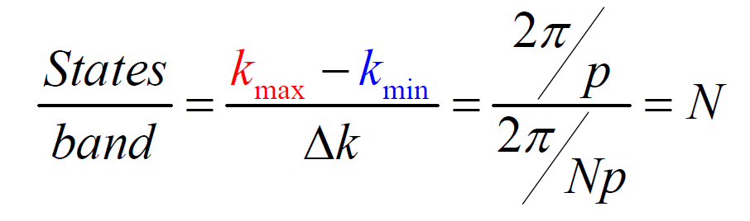
Brillouin Zone and Number of States

Slide 15
Periodic Potential: Bloch function
V
V₀
II
I
x
-b
0
a

Slide 16
Periodic Potential: Bloch function
(I)
Bloch function
(II)
Wave function
Periodic function: varies with lattice constant and direction
(I)
(II)

Slide 17
Periodic Potential: Bloch function
V
V₀
II
I
x
-b
0
a

Slide 18
Periodic Potential: Bloch function
V
V₀
II
I
x
-b
0
a

Slide 19
Periodic Potential: Bloch function

Slide 20
Periodic Potential: Bloch function

Slide 21
Periodic Potential: Bloch function
+1
π
2π
3π
4π
5π
-1
For P=(3/2)π

Slide 22
Periodic Potential: Bloch function
If V₀b, i.e. potential barrier strength, is large then P is also large then the curve will be more steep and the allowed bands will be narrower
If V₀b, i.e. potential barrier strength, is low then P is also low then the allowed bands will be narrower
If P value goes to “zero” then
If P value goes to “infinity” then

Slide 23
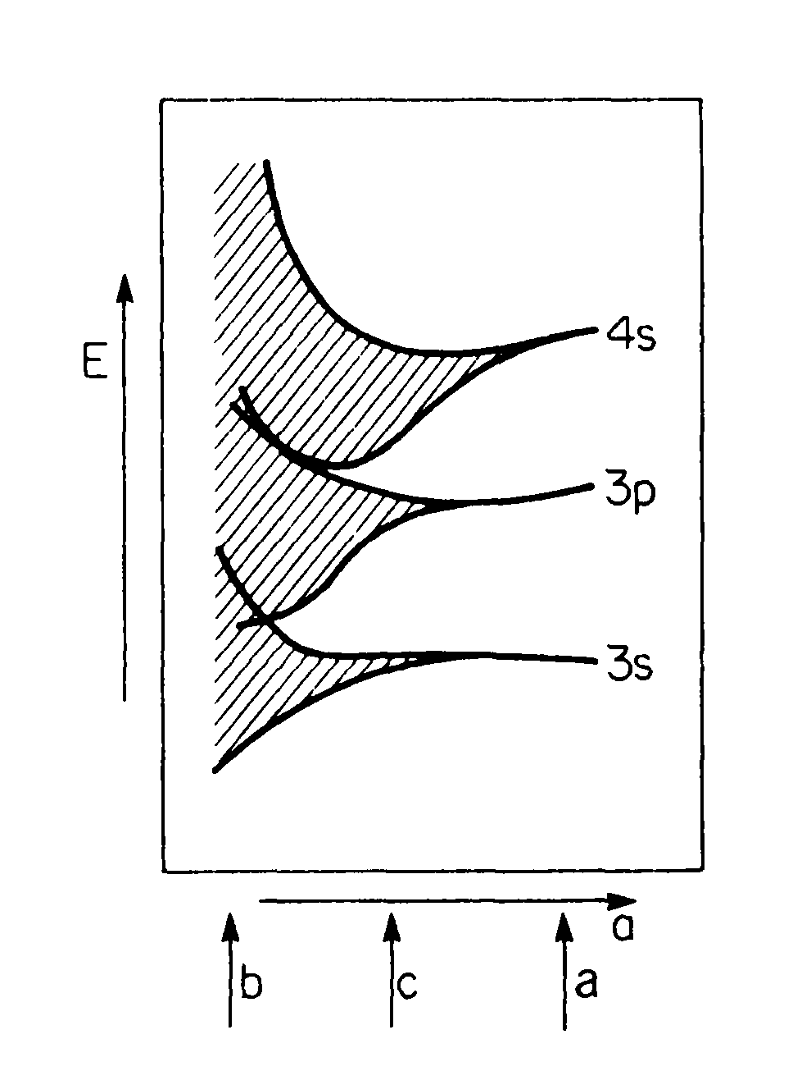

Slide 24
End of Class # 4

